Slide 1
What is location data and big data marketing? Location data can be seen as a branch of big data. When the term big data is used people generally think first about quantity. Whilst this probably has to do with the reason that the terms exist, big data isn’t really about quantity. We think that data is big in the sense that the impact is big. We think of location data as big because of it’s quality in both application and insight.

Slide 2
What is location data and big data marketing?
With that in mind, we can define big data as the collation of data from multiple sources. To inform better decision making, powerful targeting and improved attribution.
Location data is big data that uses information about a person or group of people’s movement or behaviour. This is used to understand wider trends and patterns. Location-based advertising and marketing use this data to fine-tune marketing efforts. But it is also used to generate better engagement and get valuable insights into customer behaviour.

Slide 3
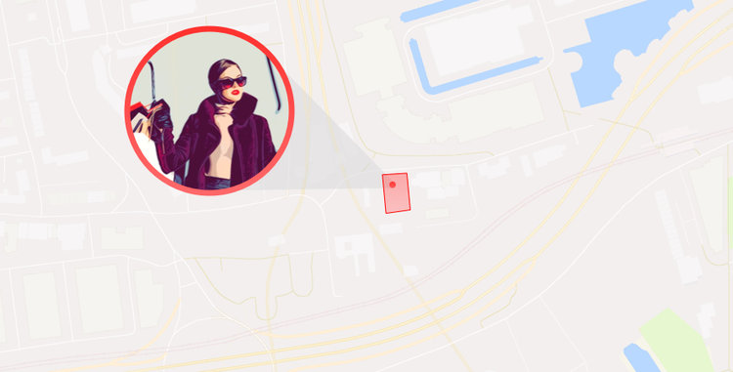
What is location data and big data marketing?
How can my business use location data
For marketers, it has sometimes been difficult to understand the benefits of location data. Especially whilst trying to get around the technical side of how it works. In the beginning, many companies had inaccurate data sets. But now the science behind location data has advanced greatly. This enables marketers by providing quick and reliable results. All by incorporating location data into their marketing strategy.
These uses are now much more accessible and easily combined with existing marketing efforts. Plug and play location-based marketing is now available. With this in mind let’s look at some of the key marketing practices that benefit from location.

Slide 4
Segmentation
Audience segmentation is a key challenge for any marketer. In order to optimize marketing dollars, it’s important to make sure that you are reaching the right people. It can sometimes be difficult to get this right, and often involves a lot of hypothesising and testing as well as optimization.
Location can help to build powerful audience segments as it’s a key indicator of intent. For example, let’s say you make the active decision to walk into a specific location in a shop. It is then likely, at some level, for you to be interested in some of the products in that location.

Slide 5
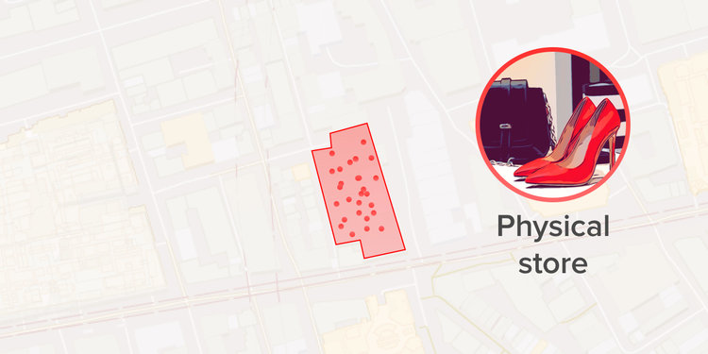
What is location data and big data marketing?
Location can also be used to build historical audiences based on location history. This means that you might target a group of people who are health nuts. You’ll have many ways of doing this currently. But location adds something that isn’t possible through traditional targeting options.
You can build an audience of people who visit gyms twice a month and have been to a dedicated health and fitness store in the past three months. If you have a strong idea of the type of target audience your product sits well with then location is a powerful tool for identifying custom segments.

Slide 6
What is location data and big data marketing?
An important point to make is that these audiences can then be used in the way that best suits your needs as a marketer. You can target them through social or send the data straight to a trading desk, DSP, DMP or other ad network. You can use it to overlay custom audiences to understand overlap. You can even use location to see the accuracy of your existing audiences and targeting.

